Slide 1


The COVID-19 Prediction Using Machine Learning
Presented to Dr Satyananda Champati Rai
ASHUTOSH SAHOO 2105610
ARYAN RAJ 21051554
SHUBHAM KUMAR 21052920
Notes:
null

Slide 2
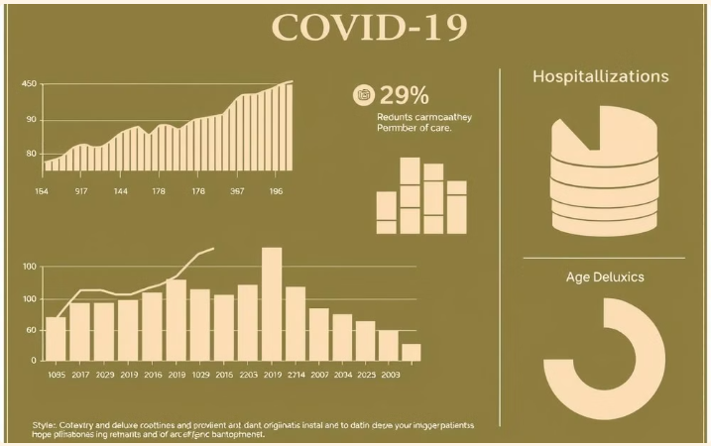
INTRODUCTION
The COVID-19 pandemic highlighted the need for advanced tools to analyze and predict its spread, aiding timely decision-making. Machine learning (ML) has emerged as a powerful approach, leveraging vast datasets to predict infection trends, mortality rates, and healthcare needs. This presentation explores the use of ML models to enhance pandemic prediction and preparedness.
Notes:
The COVID-19 pandemic has had a profound impact globally, and there is a critical need to understand and predict its trajectory.
Machine learning offers powerful tools to analyze complex data and forecast the spread and impact of the virus.
In this presentation, we will explore how various machine learning techniques can be applied to COVID-19 prediction and modeling.
We will discuss the key data sources, modeling approaches, and the potential benefits and limitations of these methods.
The goal is to provide insights that can inform public health decision-making and help mitigate the ongoing effects of the pandemic.
null

Slide 3
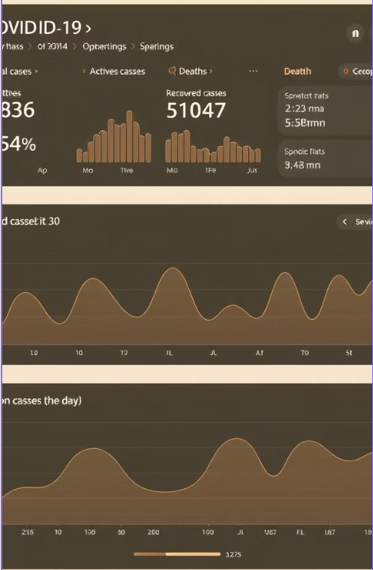

OBJECTIVES
Predict Outbreaks
1
Develop models to forecast COVID-19 case trends and hotspots.
Optimize Resource Allocation
2
Use predictions to guide the distribution of medical supplies and personnel.
Inform Policy Decisions
3
Provide data-driven insights to support public health interventions.

Slide 4

CHALLENGES
1
Rapidly Evolving Situation
The dynamic nature of the pandemic makes it difficult to anticipate and respond to emerging trends.
2
Limited Data
Collecting and processing the vast amount of data required for accurate predictions poses significant challenges.
3
Coordinating Response
Effective pandemic management requires seamless coordination across various stakeholders and levels of government.
Notes:
null

Slide 5
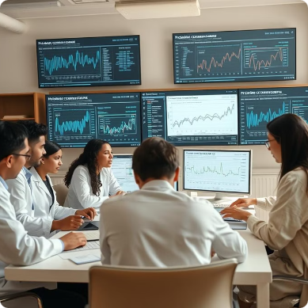
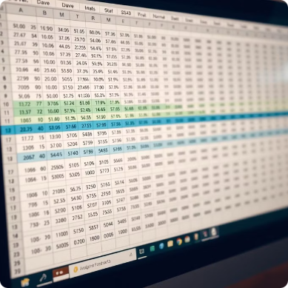


Data Collection and Preprocessing
Data Sources
Data Preprocessing
Feature Engineering
Aggregate data from government agencies, healthcare providers, and public data repositories.
Clean, normalize, and integrate diverse data sources to create a comprehensive dataset.
Identify and extract relevant features from the data to feed into the machine learning models.
Notes:
null

Slide 6
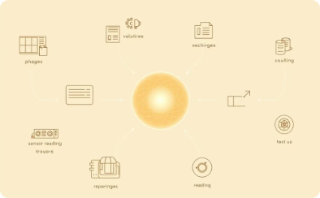

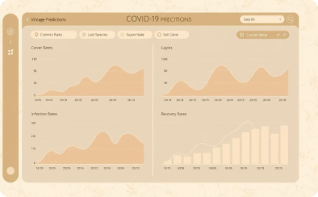

IMPLEMENTATION
Data Ingestion
Model Training
Visualization
Deployment
Seamlessly integrate and process data from various sources.
Continuously train and optimize the machine learning models.
Develop intuitive dashboards to present insights and forecasts.
Deploy the system in a scalable, cloud-based infrastructure.
Notes:
null

Slide 7
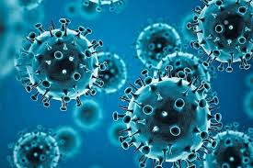
APPLICATION
Predicting the number of cases and spread trends to guide preventive measures.
Healthcare Resource Management: Optimizing allocation of hospital beds, ICU units, and ventilators based on predicted demand.
Sentiment and Behavioral Analysis: Analyzing public response and compliance with health measures through social media data.
Risk Assessment: Identifying high-risk groups based on comorbidities, demographic data, and health records.
Mortality and Recovery Prediction: Estimating outcomes for infected patients to prioritize critical care needs.
Notes:
null

Slide 8
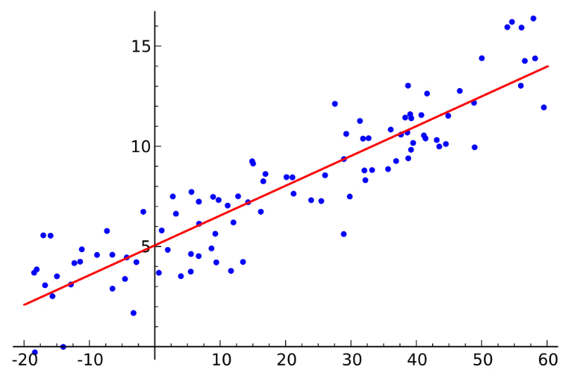
MACHINE LEARNING ALGORITHMS
AND METHODS
Linear Regression
Linear regression is a simple yet powerful technique for modeling the relationship between a dependent variable and one or more independent variables.
Limitations:
Poor performance on non-linear data.
Sensitive to outliers and multicollinearity.
Notes:
3

Slide 9
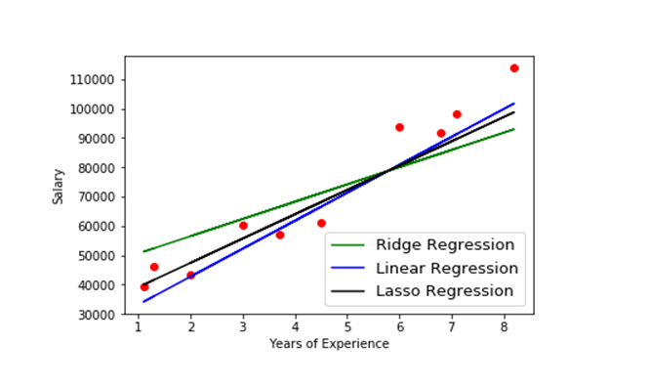
Ridge and Lasso Regression
Ridge Regression
Ridge regression adds a penalty term to the cost function, shrinking the coefficients towards zero to prevent overfitting.
Lasso Regression
Lasso regression also adds a penalty term, but uses L1 regularization, which can result in sparse models by setting some coefficients to zero.
Comparison
Ridge is better for models with many predictors, while Lasso is more suitable for variable selection and sparse models.
Notes:
5

Slide 10
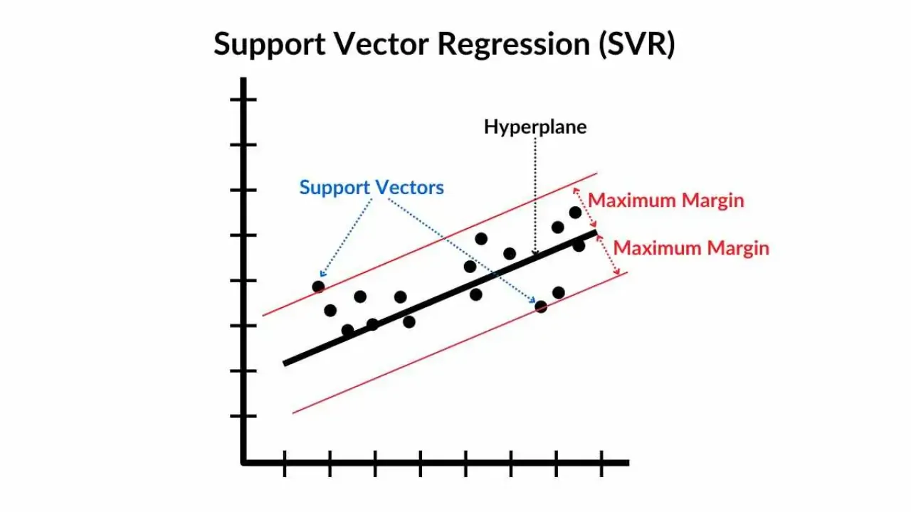
Support Vector Regression (SVR)
A regression algorithm that uses Support Vector Machines to predict continuous values.
Predicts continuous values using Support Vector Machines.
Handles non-linear relationships with kernel functions (e.g., RBF, Polynomial).
Robust to outliers with epsilon-insensitive margin.
Applications:
Stock price prediction, demand forecasting, etc.
Notes:
8

Slide 11

Polynomial Features
A preprocessing technique that generates polnomial combinations of the original features.
Expands feature space to capture non-linear relationships.
Degree of polynomial defines the complexity of the model.
Notes:
9

Slide 12
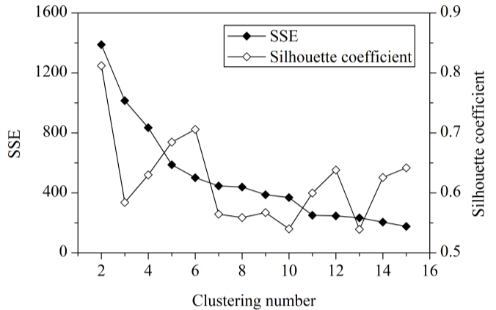
Silhouette Analysis
->A technique to evaluate clustering quality.
->Evaluates clustering quality using silhouette scores (-1 to 1).
->Measures how well a point fits within its cluster compared to others.
->Useful for validating clustering algorithms like K-means.
Applications:
Assessing K-means, DBSCAN, or hierarchical clustering models.
Notes:
15

Slide 13
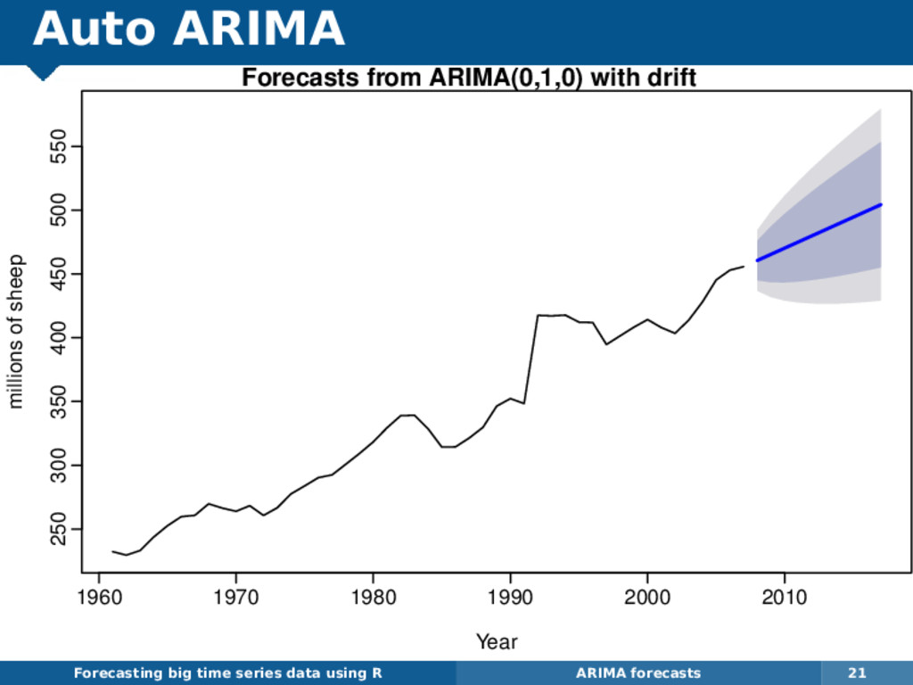
Auto ARIMA
Automates the process of selecting the best ARIMA (AutoRegressive Integrated Moving Average) parameters.
Automatically identifies p,d,q values using AIC/BIC scores.
Seasonal ARIMA (SARIMA) support with seasonal parameters.
Applications:
Sales forecasting, weather predictions, etc.
Notes:
11

Slide 14
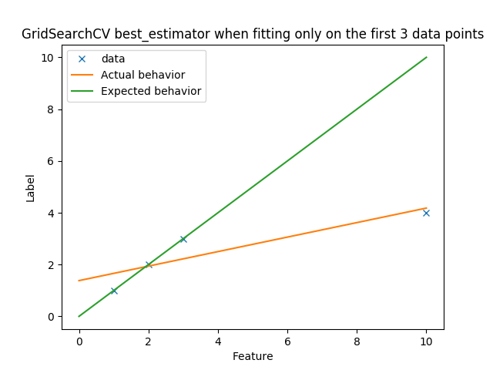
GridSearchCV
Exhaustive search over specified hyperparameter values for an estimator
Optimizes model hyperparameters via exhaustive search.
Uses cross-validation to evaluate parameter combinations.
Balances accuracy and computational cost.
Applications:
Applications: Model tuning for SVM, Random Forest, Neural Networks, etc.
Notes:
13

Slide 15
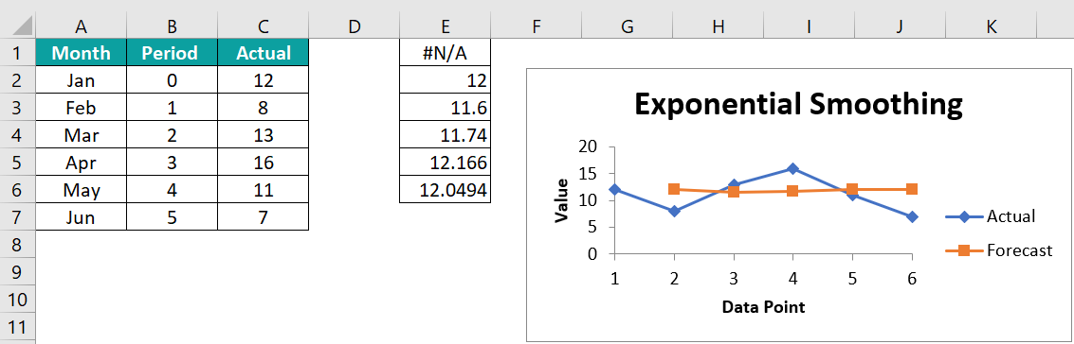
Exponential Smoothing Models
Forecasting methods that apply exponentially decreasing weights to past observations.
Flexible models for various time-series patterns.
Challenges:
-Requires proper parameter tuning.
-Limited for complex, highly irregular time series
Applications:
Demand forecasting, inventory management, etc.
Notes:
16

Slide 16


CONCLUSION
Machine learning models provide accurate predictions of COVID-19 trends, enabling informed decision-making.
Predictions help allocate resources, such as hospital beds and ventilators, more effectively.
Timely forecasting supports early interventions to reduce the spread of the virus.
Issues like data quality, model generalizability, and ethical concerns must be tackled for broader adoption.
Notes:
The key takeaway is that machine learning-powered COVID-19 prediction systems can be incredibly valuable in helping communities become more resilient and prepared for pandemics.
These systems have the ability to analyze huge amounts of data to identify early warning signs of outbreaks. This allows public health officials to act quickly and take steps to mitigate the spread of the virus.
By leveraging the power of data and advanced analytics, we can build more effective pandemic response capabilities and better protect our communities in the face of future health crises.
null

Slide 17
THANKS YOU

